Slide 1
NDN DoS Simulation
Vishrant Vasavada, Siva Kesava

Slide 2
Motivation
The Internet today has many bad guys trying to exploit the architecture and conduct various network attacks .
Denial of Service (DoS) and Distributed Denial of Service (DDoS) have become much notorious and more common in recent years.
It is thus necessary to check resilience of NDN towards such attacks.
How far can NDN prevent the attack by design?
Does NDN require any additional security addition to make it invulnerable?

Slide 3
About NDN
NDN uses a pull-model where it fetches data from the network using interest packets
Besides Forwarding Information Base (FIB), the other two basic components of NDN are: Pending Interest Table (PIT) and Content Store(Cache).
Because of its stateful forwarding, NDN router can keep track of traffic composition as well as interest satisfaction ratio.
Moreover, since traffic gets cached along the way, not all interests make it to the target
We believe that this behaviour of NDN allows for built-in security against DoS and simulate the results for the same

Slide 4
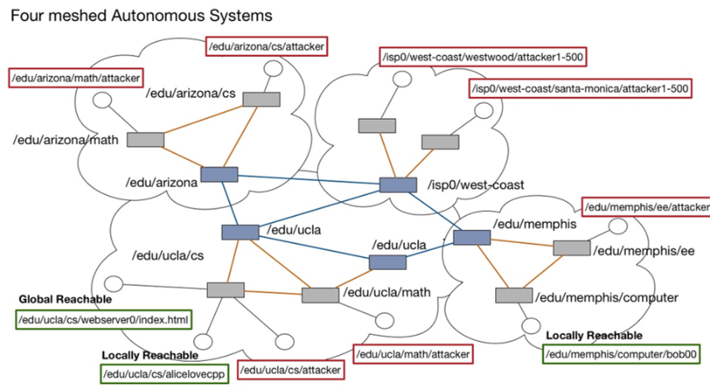
Topology

Slide 5
ndnSIM
For our simulation, we use ndnSIM
ndnSIM is designed to examine and evaluate various components of NDN architecture by modelling topologies and simulating traffic
ndnSIM automatically appends sequence number to interest packets sent out by in-built consumer.
E.g. If producer’s prefix is “/prefix” and if we set consumer’s interest prefix as “/prefix/xyz”, the interest packets generated will be /prefix/xyz/1, /prefix/xyz/2, etc. All these will be valid interests accepted by producer.
This makes it impossible to send out fake interest to producer.
Hence, we build our own producer and consumer app
Consumer can choose whether to auto-append sequence number to its interest prefix to make it valid. Without sequence number, producer will infer it as fake interest (e.g. /prefix/xyz/1 is valid interest but /prefix/xyz is not)

Slide 6
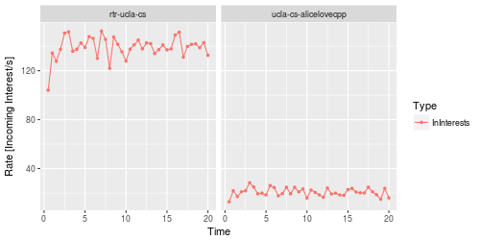
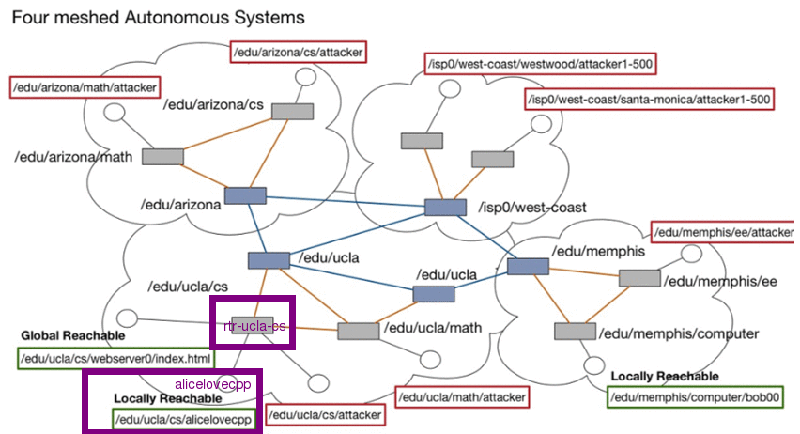
Scenario 1: Locally Reachable Producer
Target: alicelovecpp (locally reachable)
Attackers outside the local network can only guess alicelovecpp prefix
Without the correct prefix, they cannot overwhelm alicelovecpp producer
However, they can overwhelm UCLA CS Router (NFD)
Conclusion: Without knowing the exact prefix you cannot overwhelm the producer

Slide 7
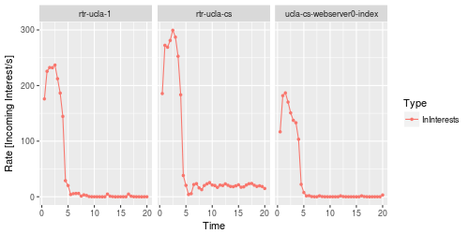
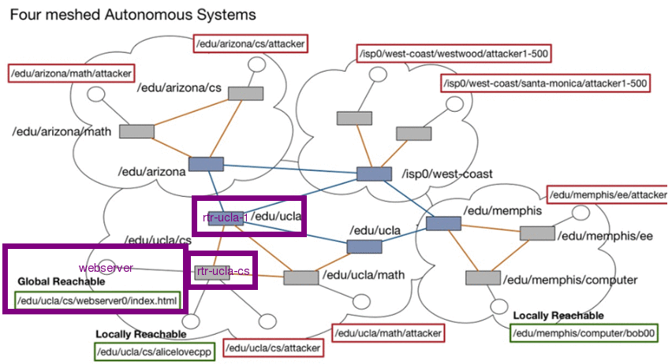
Scenario 2: Cache can withhold much traffic
Target: webserver (globally reachable)
Cache in intermediate routers along the path to victim can serve valid interests towards victim
Hence, the traffic at webserver, UCLA CS Router, and UCLA Border Router will eventually decrease.
Conclusion: If cache size is large enough and attacker keeps requesting valid interests, NDN Content Store can provide resilience to DoS traffic

Slide 8
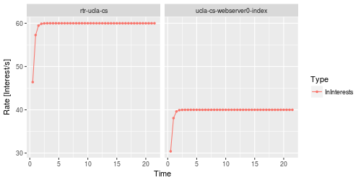
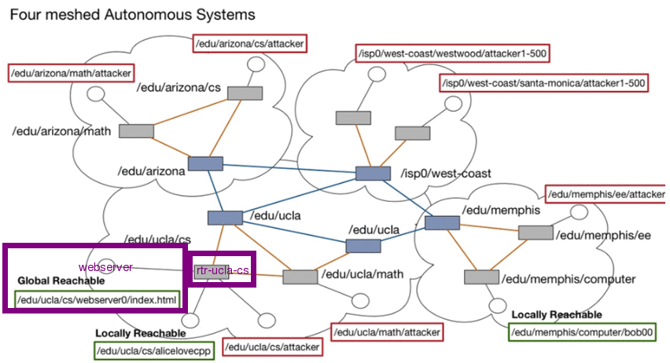
Scenario 3: Interest Aggregation
Target: webserver (globally reachable)
UCLA CS Router aggregates interests with same prefix from several attacks and forwards only one interest, thus reducing the total forwarded traffic
Stateful Forwarding: Traffic Composition (useful when cache isn’t)
Conclusion: Interest aggregation helps to reduce total forwarded traffic towards producer

Slide 9
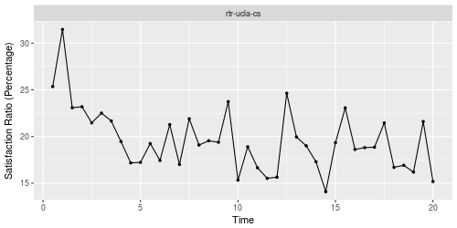
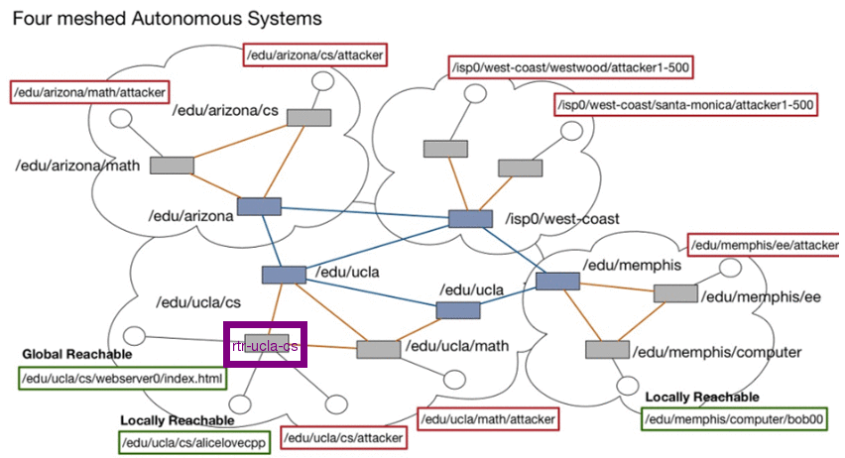
Scenario 4: Interest Satisfaction
Target: webserver (globally reachable)
With more and more fake interests, UCLA CS Router will see decline in interest satisfaction ratio (Satisfied interests/Incoming Interests)
Conclusion: If NDN Router starts hitting low satisfaction ratio, it is likely to be under DoS attack

Slide 10
Summary and Future Work
In this project, we performed initial analysis of NDN’s resilience to DoS traffic using ndnSIM
We show that NDN Content Store and Interest Aggregation can help mitigate the DoS Traffic
Interest Satisfaction ratio and traffic composition can help to detect DoS attack
Next Steps:
Simulate few more scenarios. For example, study how NDN uses load balancing when attack occurs
Study how to control name prefix routing announcements to stop DDoS by interest flooding
Incorporate defense mechanisms to DoS attacks in ndnSIM code
Simulate the DoS attack and defense on real NDN Testbed

